Slide 1
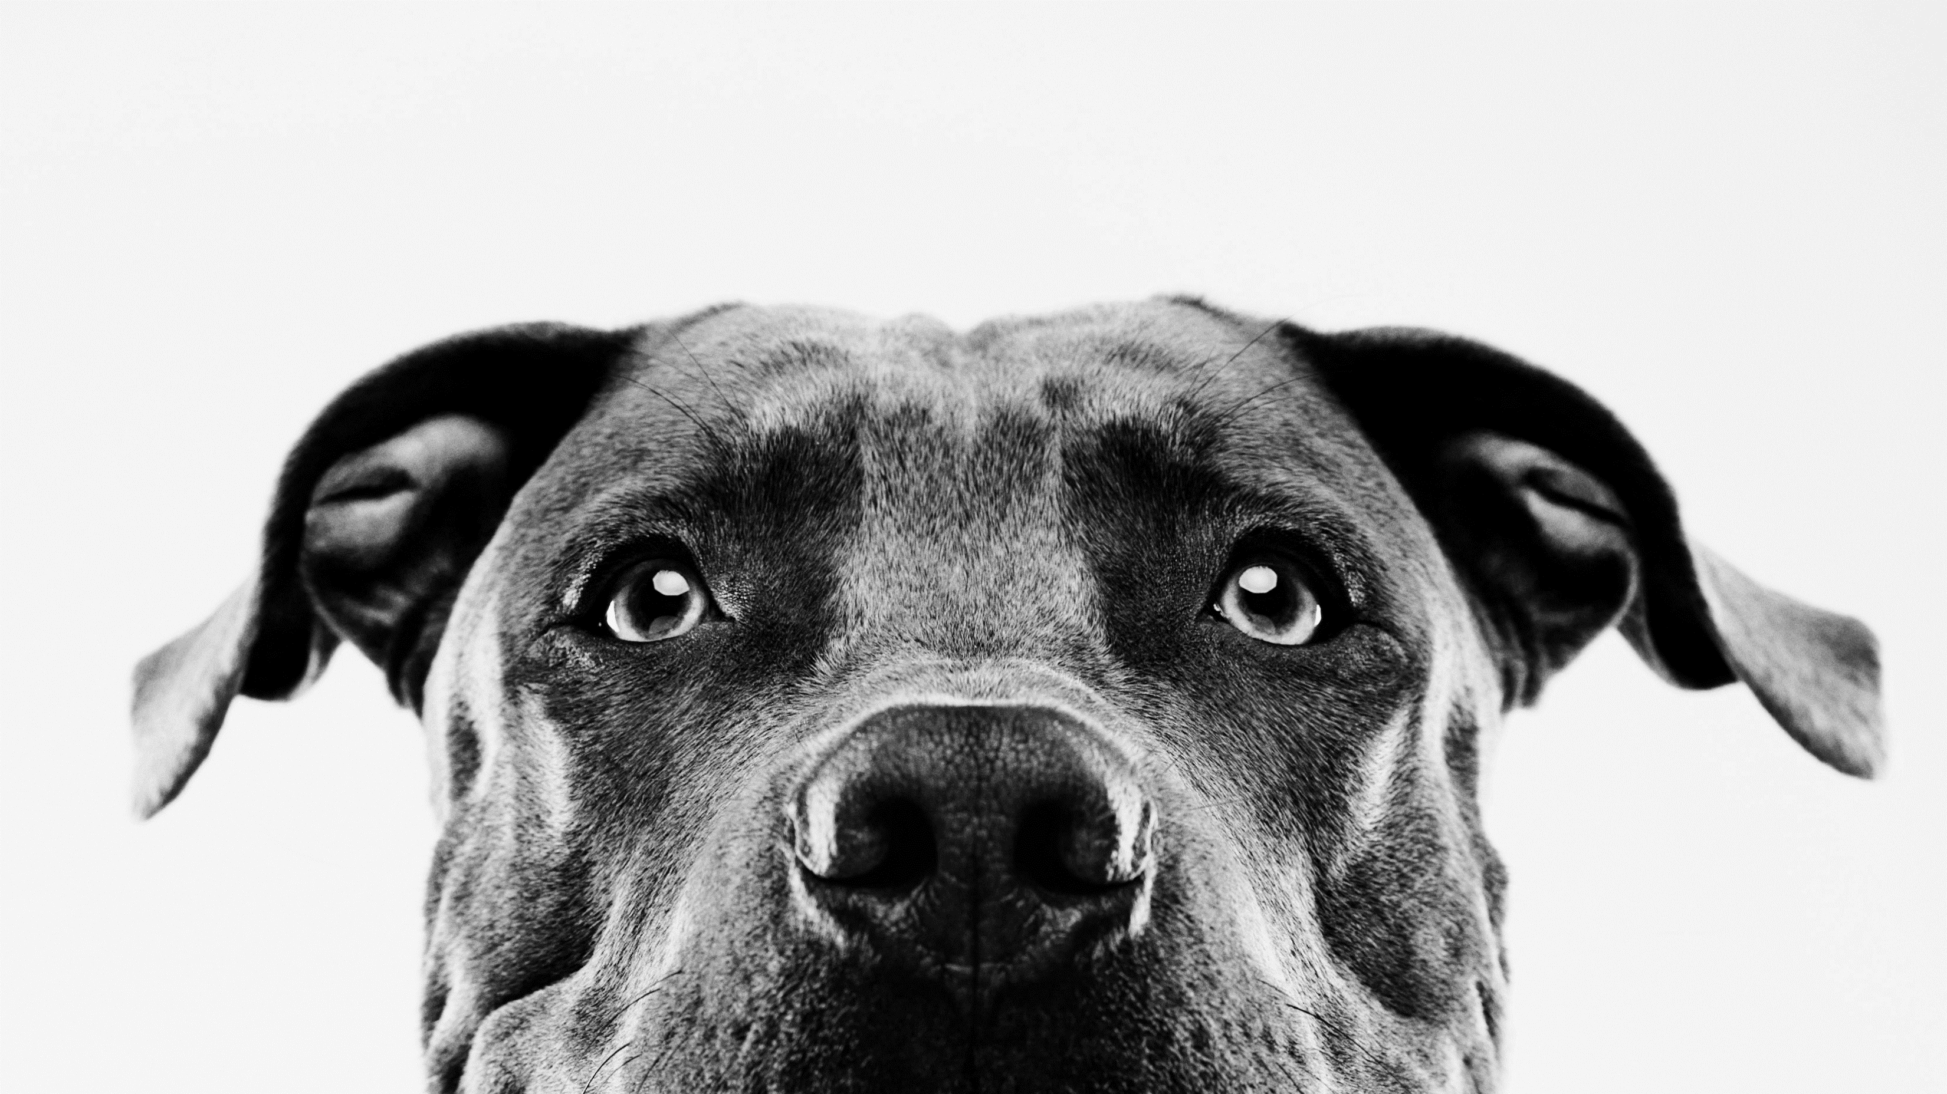
Pet adoption predictions
M2k, Inc.

Slide 2
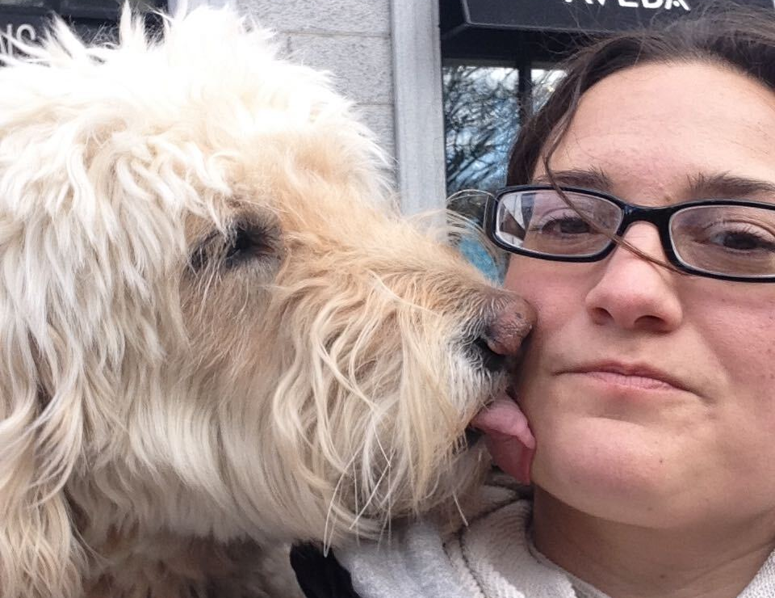
M2K Team
KRISTIN ASPROMONTI
PROJECT MANAGER
Notes:
What was interesting about the flow of this project was how it evolved over time. It began with a simple dataset. They had provided both test and training data, pictures, metadata and the encoded files. After running that through several models we were getting pretty low scores.

Slide 3
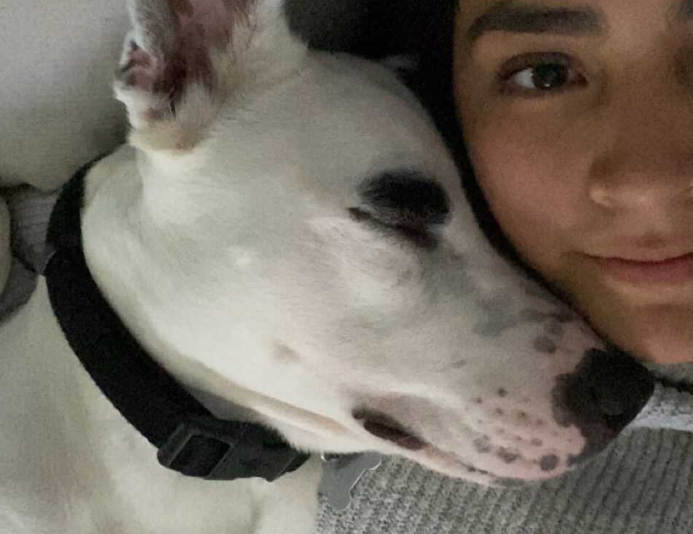
M2K Team
MELISSA HAZELGREEN
DATA ANALYST
Notes:
What was interesting about the flow of this project was how it evolved over time. It began with a simple dataset. They had provided both test and training data, pictures, metadata and the encoded files. After running that through several models we were getting pretty low scores.

Slide 4


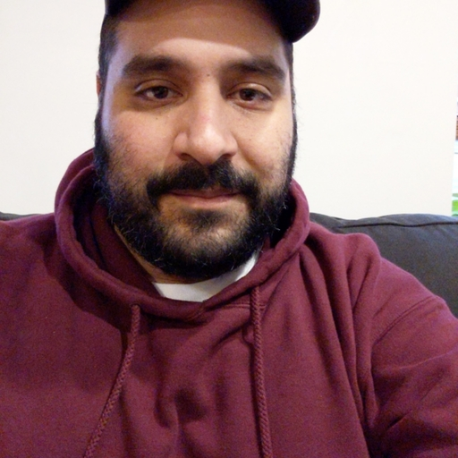
M2K Team
MARK PASRICHA
LEAD DEVELOPER
(future dog adopter)
Notes:
What was interesting about the flow of this project was how it evolved over time. It began with a simple dataset. They had provided both test and training data, pictures, metadata and the encoded files. After running that through several models we were getting pretty low scores.

Slide 5
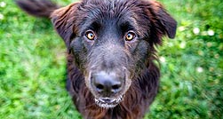
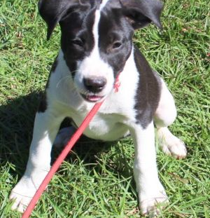
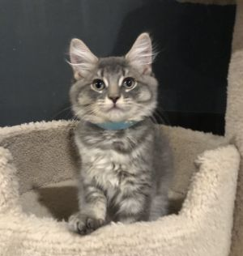
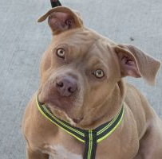

Slide 6
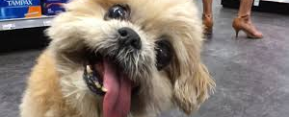
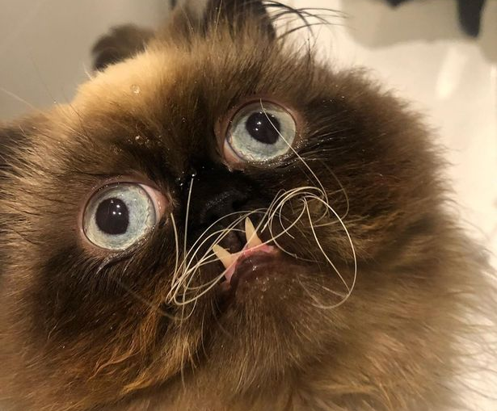
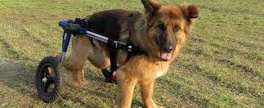
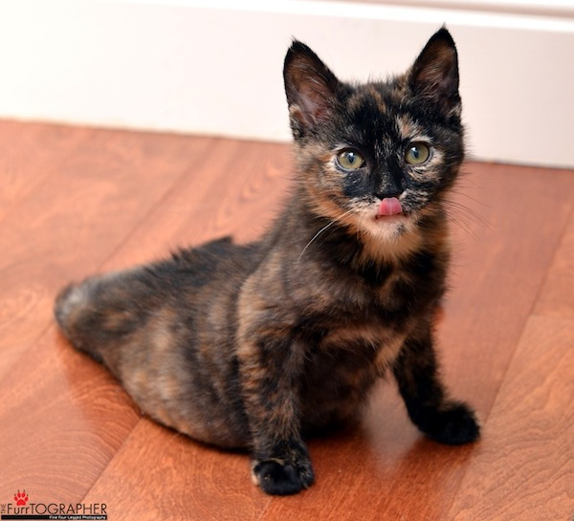

Slide 7
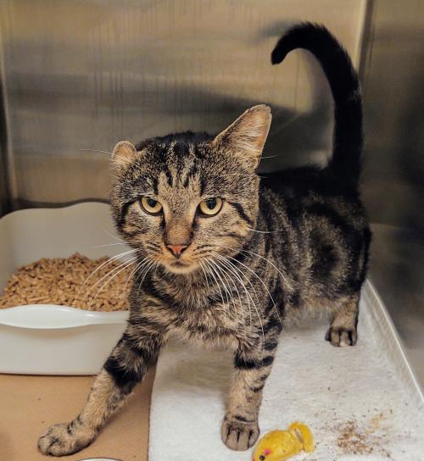
Objective
TO positively influence Adoption outcomes FOR ANIMALS THAT ARE LEAST LIKELY TO BE ADOPTED

Slide 8
ETL
MODEL
PREDICT
RESOURCES
Kaggle
Petfinder API
DEPENDENCIES
Jupyter Notebook
Pandas
Tensorflow
Sklearn
Sqlalchemy
Flask
OAuth2
Requests
Plotly
LANGUAGES
Python
JavaScript
HTML
SQL
Notes:
What was interesting about the flow of this project was how it evolved over time. It began with a simple dataset. They had provided both test and training data, pictures, metadata and the encoded files. After running that through several models we were getting pretty low scores.

Slide 9


our story
Original dataset from a Kaggle competition
Tested various models – returned low scores
API to Petfinder.com to supplement data
Simultaneously running ML on API and Kaggle data
Developed a website that will return the predicted adoption of an animal
Notes:
What was interesting about the flow of this project was how it evolved over time. It began with a simple dataset. They had provided both test and training data, pictures, metadata and the encoded files. After running that through several models we were getting pretty low scores.

Slide 10





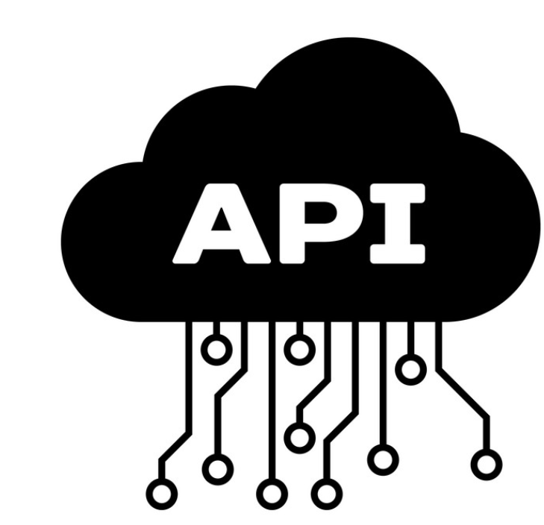
The process
Training Data (2 Datasets)
Current
*Adoptability Score:
Same day Adoption
1 - 7 days
8 - 30 days
31 - 90 days
No adoption > 100 days
Kaggle Dataset
Future
Postgres db
ML-Neural Network
Predicted Adoptability Score*
Petfinder API

Slide 11


The website
*Adoptability Score:
Same day Adoption
1 - 7 days
8 - 30 days
31 - 90 days
No adoption > 100 days
New Pet Intake
New Pet Entry via Form
ML-Neural Network
Predicted Adoptability Score
PetFinder Search
Predicted Adoptability Score
Petfinder API

Slide 12
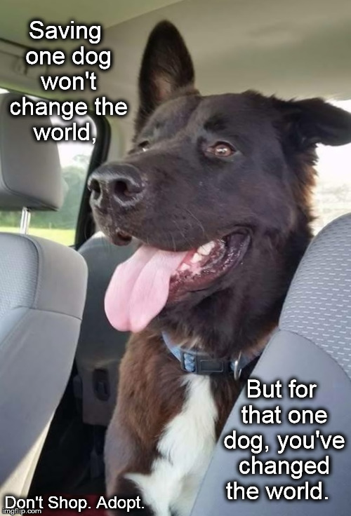
How can this info help?
Introducing the benefits of data and analytics to the process
Marketing strategies can be formulated around the dogs with the lowest scores.
Fostering initiatives implemented to maximize the likelihood of adoption
Manage shelter capacity
Notes:
What was interesting about the flow of this project was how it evolved over time. It began with a simple dataset. They had provided both test and training data, pictures, metadata and the encoded files. After running that through several models we were getting pretty low scores.

Slide 13
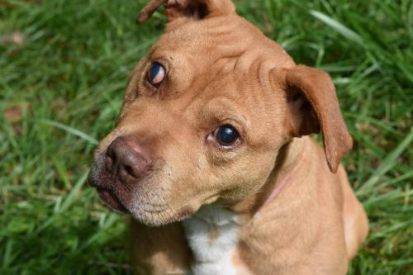
Machine learning

Slide 14
Features
X Data (Features)
Type — Type of animal (1 = Dog, 2 = Cat)
Age — Age of pet when listed, in months
Breed1 — Primary breed of pet
Breed2 — Secondary breed of pet, if pet is of mixed breed
Gender — Gender of pet
Color1 — Primary color
Color2 — Secondary color
Color3 — Tertiary color
Maturity Size — Size at maturity
Fur Length — Fur length (short, medium, long, n/a)
Vaccinated — Pet has been vaccinated
Dewormed — Pet has been dewormed
Sterilized — Pet has been spayed / neutered
Health — Condition (healthy, minor or serious injury, n/a)
Fee — Adoption fee
Video Amt — Total uploaded videos
Photo Amt — Total uploaded photos
Y Data (Outcome)
Adoption Speed — Categorical speed of adoption. Lower is faster. This is the value to predict. See below section for more info.

Slide 15
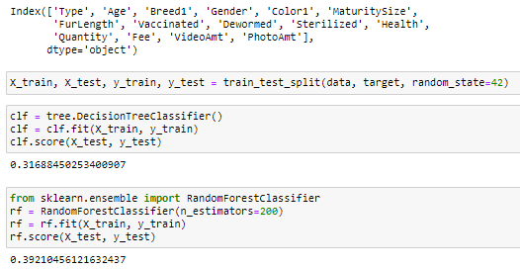
Model testing
Random Forest
Feature Importances (descending)
0.14741186964735833, 'PhotoAmt',
0.1384766037034141, 'Age',
0.08720990747064314, 'Color2',
0.08619369519743096, 'Color1',
0.07978128044193844, 'Breed1',
0.05670749658762525, 'Breed2',
0.04668041534450266, 'Gender',
0.04610776610487081, 'FurLength',
0.044909854872647516, 'Quantity',
0.0435481770743158, 'MaturitySize',
0.04310818288981375, 'Fee',
0.04267356603221559, 'Color3',
0.03709335544122785, 'Dewormed',
0.034460276487706214, 'Vaccinated',
0.03262714745250069, 'Sterilized',
0.012845234338030878, 'VideoAmt',
0.010980521552933506, 'Health',
0.00918464936082452, 'Type'

Slide 16
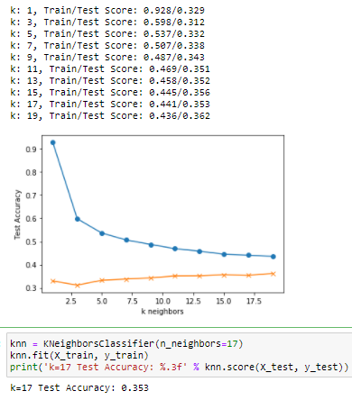
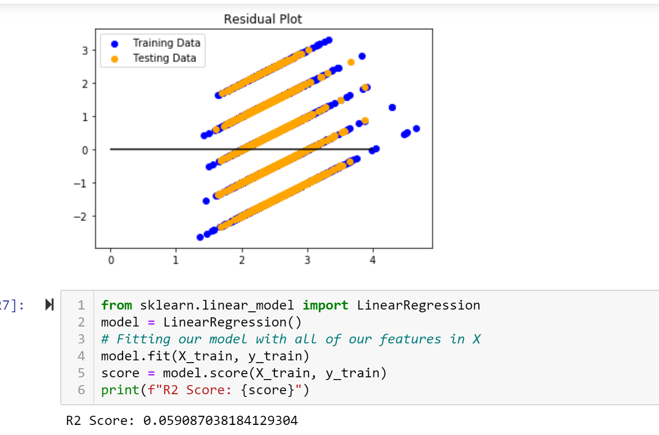
Model testing
KNN Model
Multi Linear Regression

Slide 17
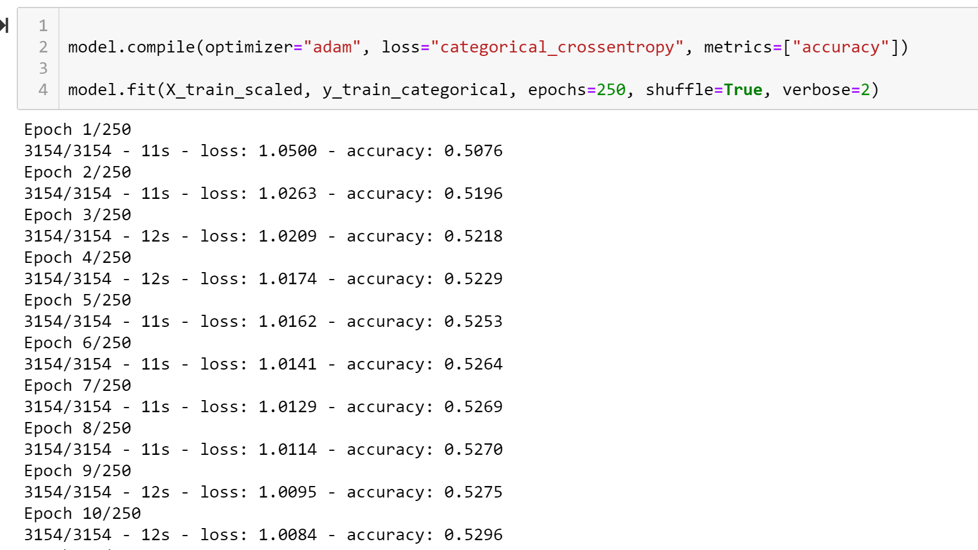
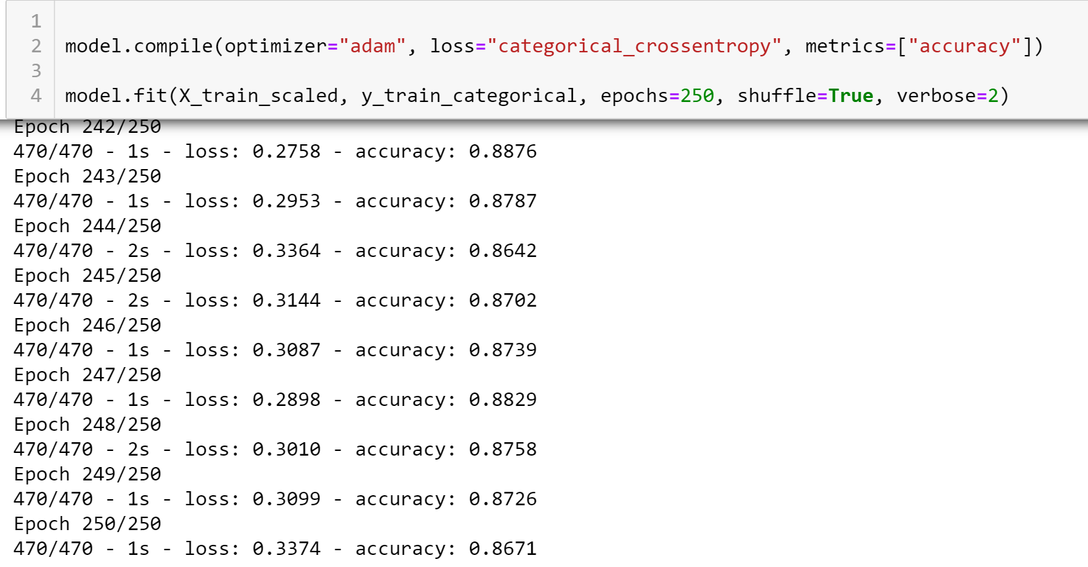
Model testing
NEURAL NETWORK
Kaggle Dataset
Petfinder Dataset

Slide 18
Model comparison summary
Neural Network |  | Multiple Linear Regression | KNN | Random Forest
Petfinder API | 0.621 | .059 | 0.353 | 0.392
Kaggle Dataset | 0.84
Notes:
Neural Network.
250 epochs sweet spot
Compare Kaggle vs api dataset and how they are testing
Hoping Additional features we can pull live will + impa

Slide 19
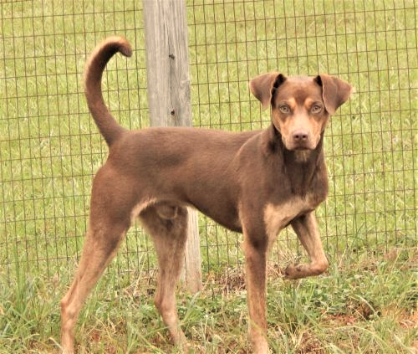
DEmo

Slide 20
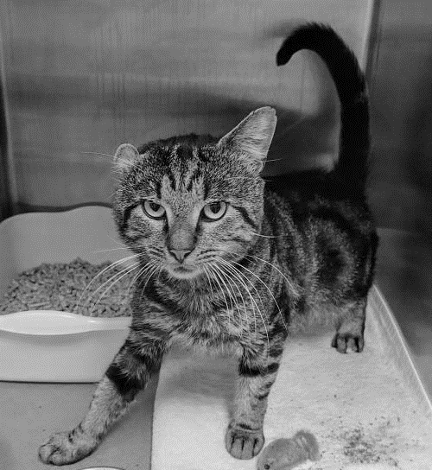
code

Slide 21
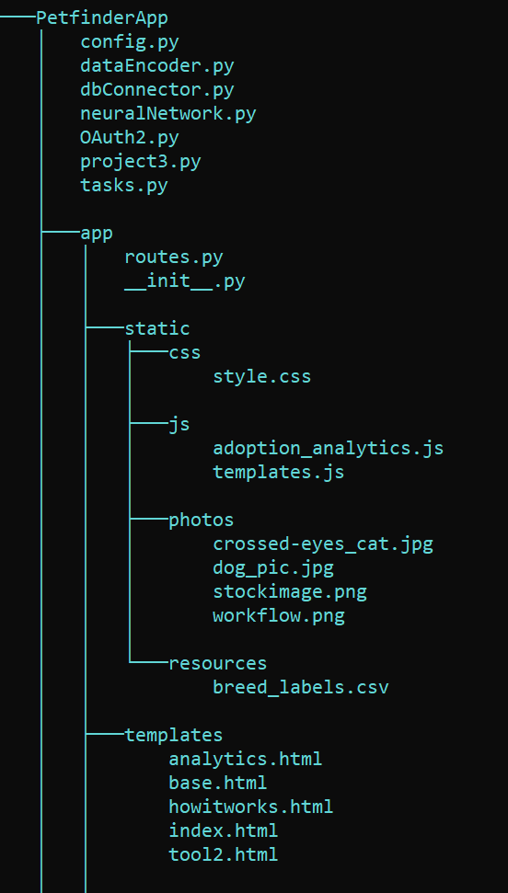
Flask App Code Structure

Slide 22
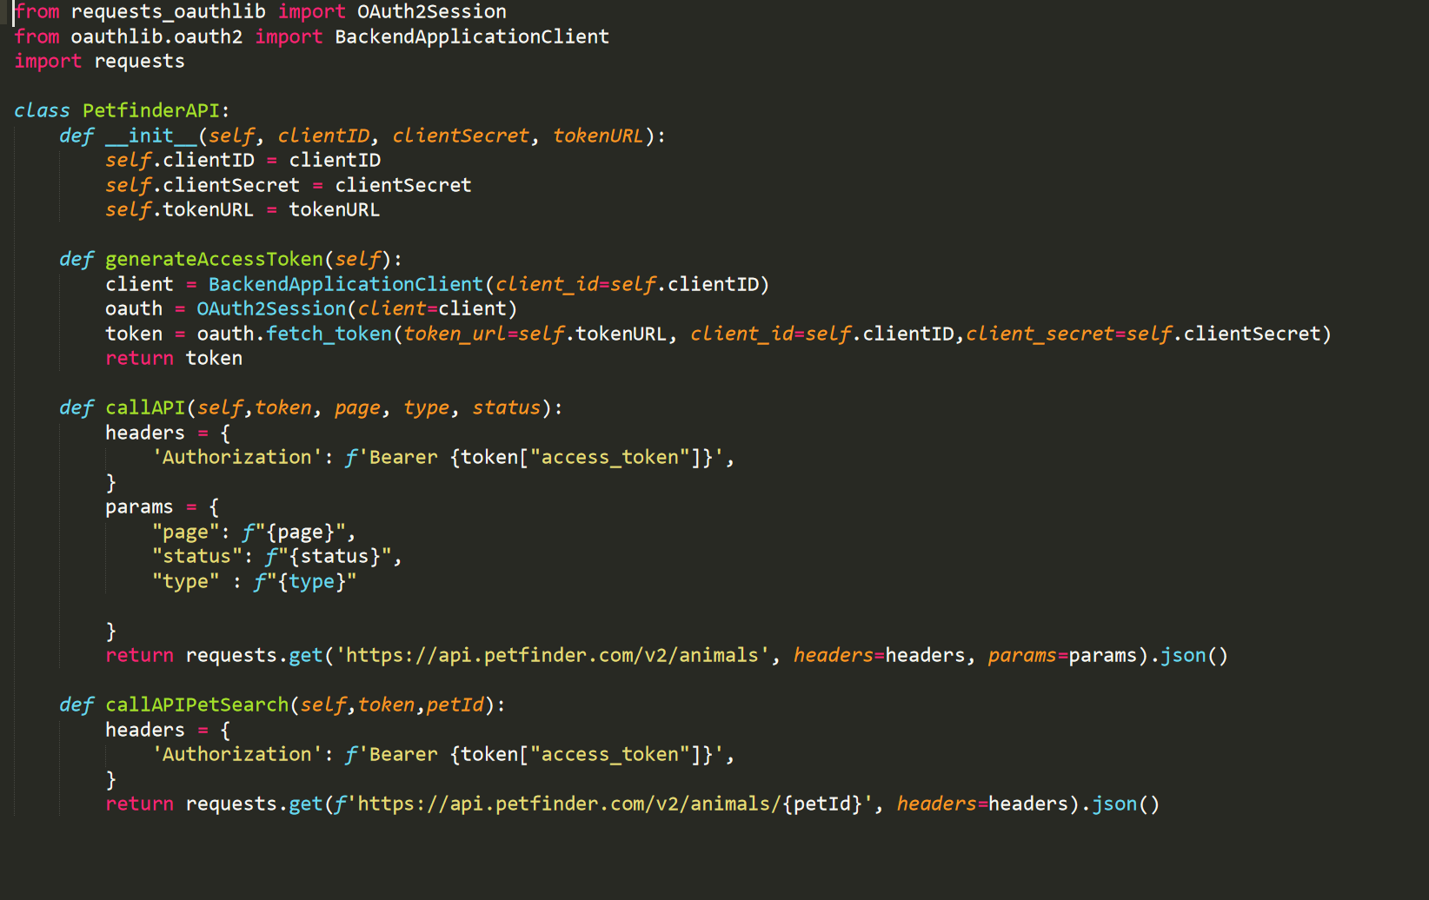
Extract: PetfinderAPI Class

Slide 23
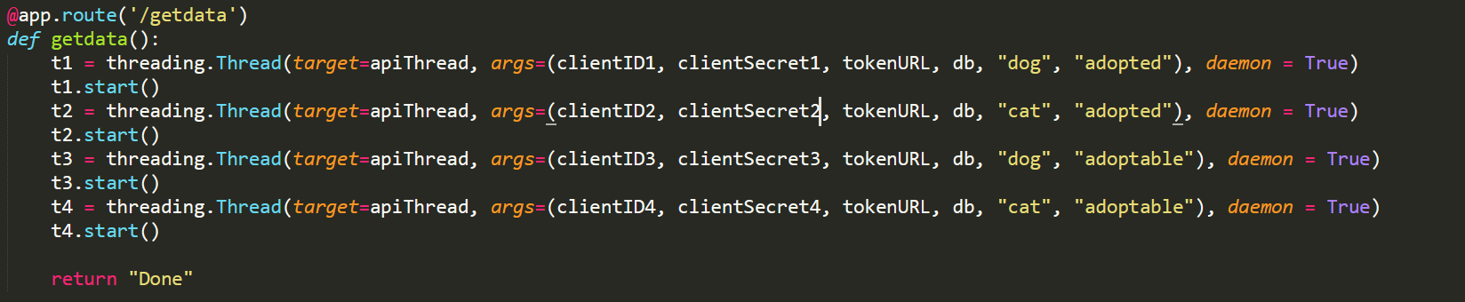
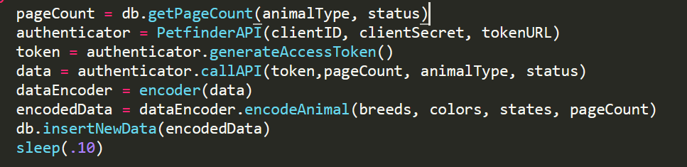
Extracting Data From Petfinder

Slide 24
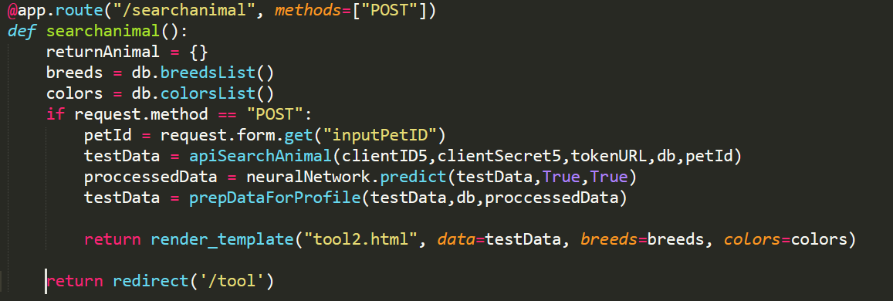
Petfinder.com Pet Search

Slide 25
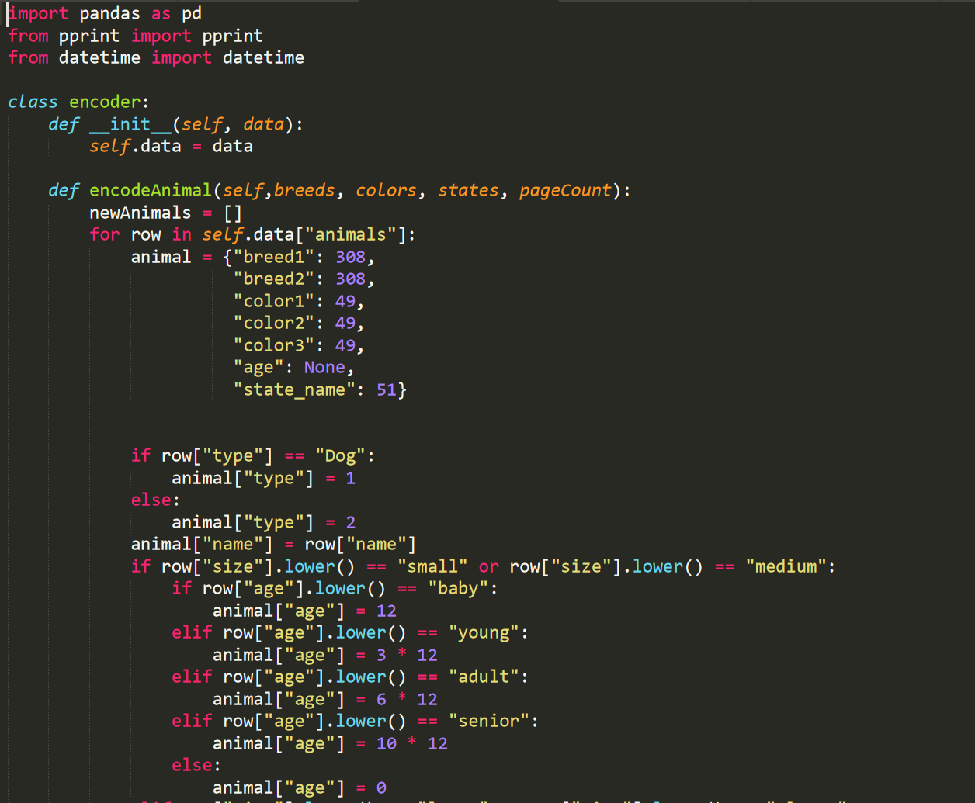
Transform: Encoder Class

Slide 26
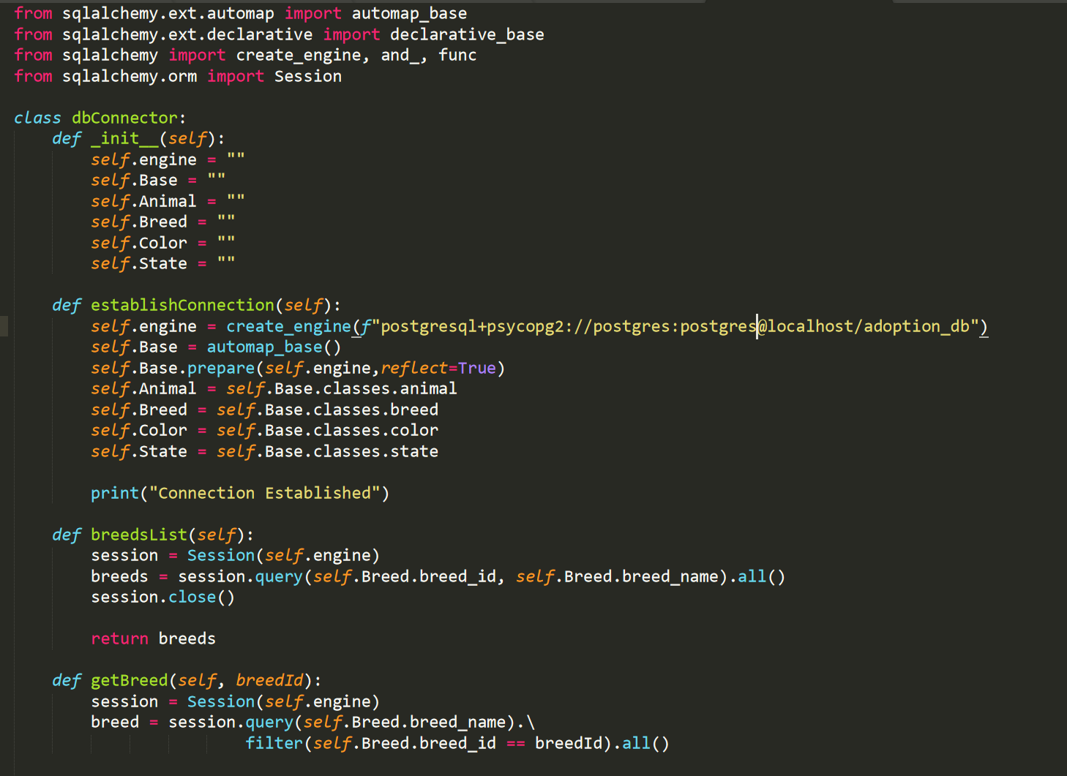
Load: DB Connector Class

Slide 27
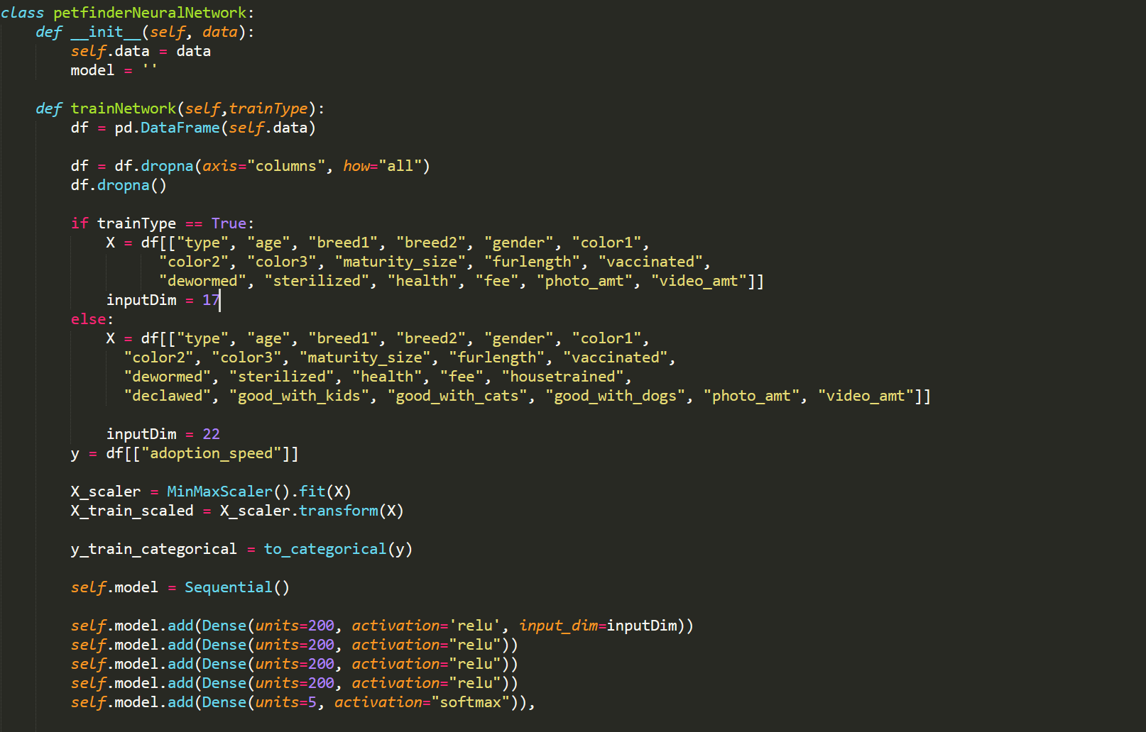
Neural Network Class

Slide 28
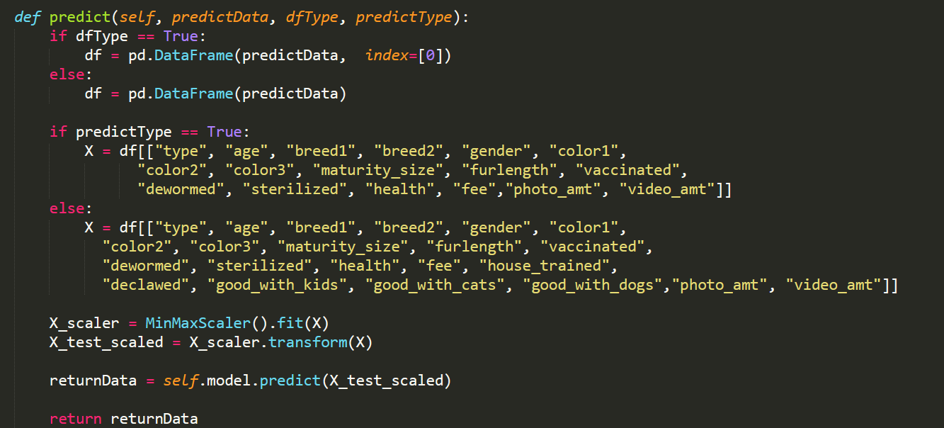
Predict

Slide 29
Future plans
Fully implement and predict from API Dataset
Store form input data to feed to the model
Update statuses via form to feed to the model
Gain deeper understanding of attributes to adoption
Enhanced web design and features
Notes:
What was interesting about the flow of this project was how it evolved over time. It began with a simple dataset. They had provided both test and training data, pictures, metadata and the encoded files. After running that through several models we were getting pretty low scores.

Slide 30
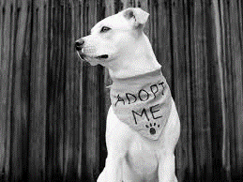
Q & A

